Slide 1
Linear Regression – PART I
Chapter 03

Slide 2
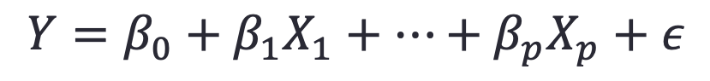
The Linear Regression Model
$$Y=β_{0}+β_{1}X_{1}+⋯+β_{p}X_{p}+ε$$
The parameters in the linear regression model are very easy to interpret.
β₀ is the intercept (i.e. the average value for Y if all the X’s are zero), β_{j} is the slope for the jth variable X_{j}
β_{j} is the average increase in Y when X_{j} is increased by one and all other X’s are held constant.

Slide 3
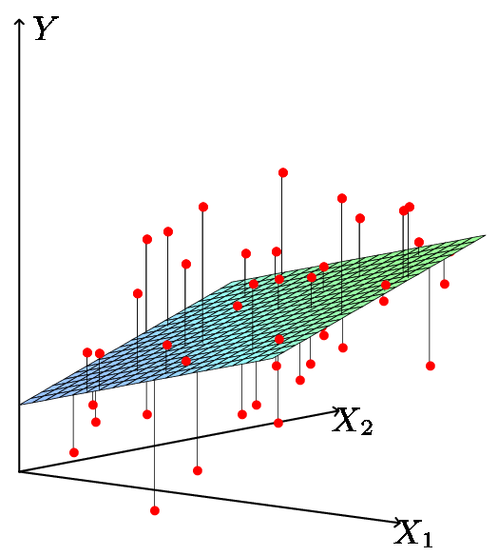
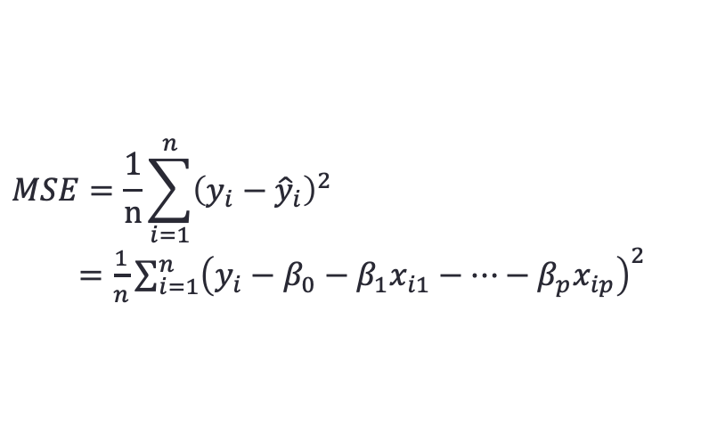
Least Squares Fit
We estimate the parameters using least squares i.e. minimize
$$MSE=\frac{1}{n}\sum_{i=1}^{n}{{\left(y_{i}−{\hat{y}}_{i}\right)}^{2}}$$
$=\frac{1}{n}\sum_{i=1}^{n}{{\left(y_{i}−β_{0}−β_{1}x_{i1}−⋯−β_{p}x_{ip}\right)}^{2}}$
Residual sum of squares RSS=nMSE

Slide 4
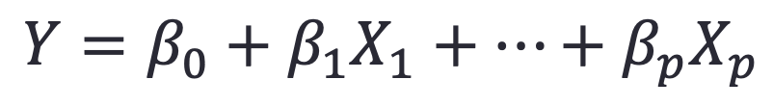
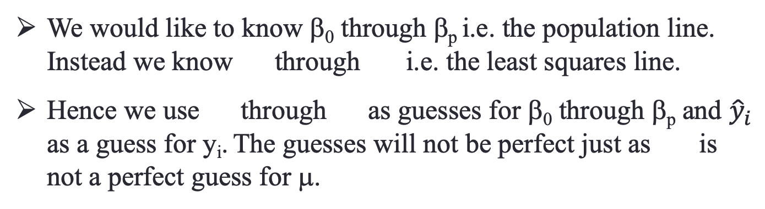
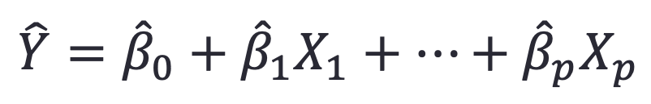
Relationship between population and least squares lines
Population line
$$Y=β_{0}+β_{1}X_{1}+⋯+β_{p}X_{p}$$
Least Squares line
$$\hat{Y}={\hat{β}}_{0}+{\hat{β}}_{1}X_{1}+⋯+{\hat{β}}_{p}X_{p}$$
We would like to know β₀ through β_{p} i.e. the population line. Instead we know through i.e. the least squares line.
Hence we use through as guesses for β₀ through β_{p} and ${\hat{y}}_{i}$ as a guess for y_{i}. The guesses will not be perfect just as is not a perfect guess for μ.

Slide 5
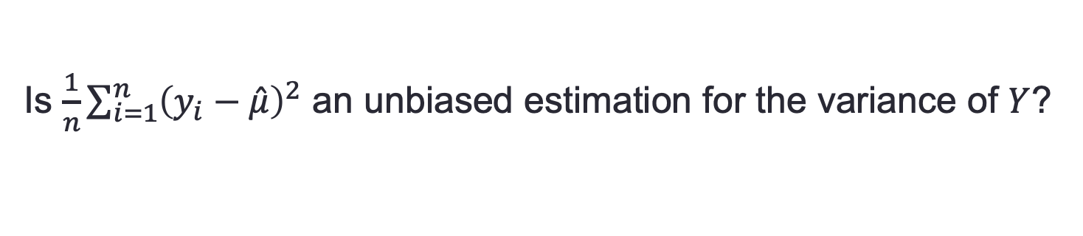
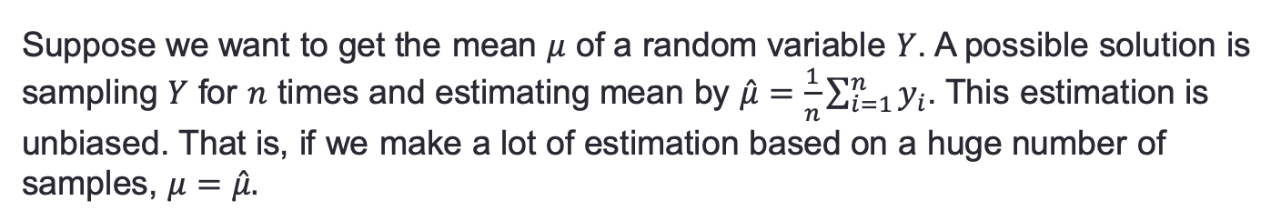
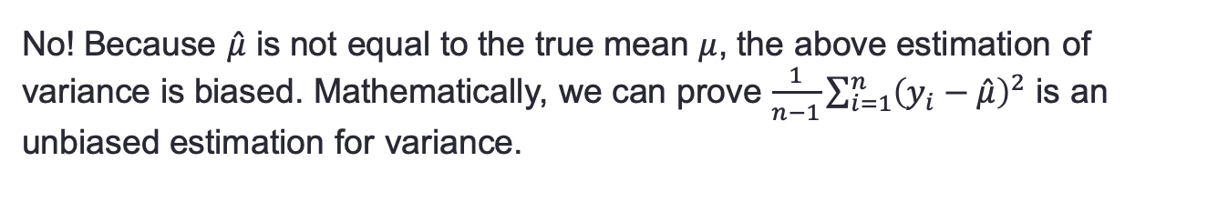
Unbiased Estimation
Suppose we want to get the mean $μ$ of a random variable $Y$. A possible solution is sampling $Y$ for $n$ times and estimating mean by $\hat{μ}=\frac{1}{n}\sum_{i=1}^{n}{y_{i}}$. This estimation is unbiased. That is, if we make a lot of estimation based on a huge number of samples, $μ=\hat{μ}.$
Is $\frac{1}{n}\sum_{i=1}^{n}{{\left(y_{i}−\hat{μ}\right)}^{2}}$ an unbiased estimation for the variance of $Y$?
No! Because $\hat{μ}$ is not equal to the true mean $μ$, the above estimation of variance is biased. Mathematically, we can prove $\frac{1}{n−1}\sum_{i=1}^{n}{{\left(y_{i}−\hat{μ}\right)}^{2}}$ is an unbiased estimation for variance.
The estimate of coefficients in linear regression model is unbiased.

Slide 6
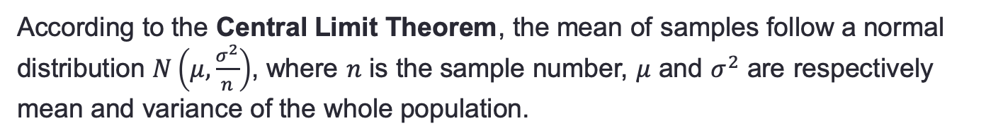
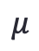
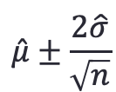
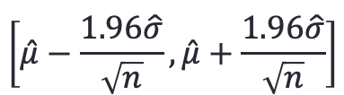
Confidence Interval
Suppose we want to know the average height of all human. It is difficult to evaluate all individuals. Hence, we need to evaluate some samples of the whole population.
According to the Central Limit Theorem, the mean of samples follow a normal distribution $N\left(μ,\frac{σ^{2}}{n}\right)$, where $n$ is the sample number, $μ$ and $σ^{2}$ are respectively mean and variance of the whole population.
$$μ$$
A 95% confidence interval indicates that the true value of $μ$ locates in the interval with a chance of 95%. For the above normal distribution, this interval is
$$\left[\hat{μ}−\frac{1.96\hat{σ}}{\sqrt{n}}, \hat{μ}+\frac{1.96\hat{σ}}{\sqrt{n}}\right]$$
or approximately,
$$\hat{μ}±\frac{2\hat{σ}}{\sqrt{n}}$$

Slide 7
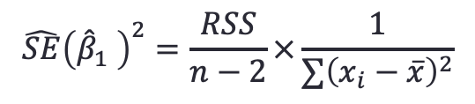
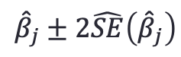
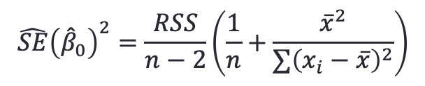
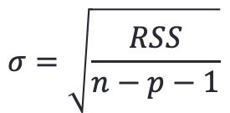

95% Confidence Interval for The Estimate of Coefficients in The Linear Model
The 95% confidence interval for the estimates of coefficients in the linear model is
$${\hat{β}}_{j}±2\hat{SE}\left({\hat{β}}_{j}\right)$$
$\hat{SE}\left({\hat{β}}_{j}\right)$ stands for the estimate of standard deviation of ${\hat{β}}_{j}$.
$σ$ is the standard deviation of the whole population and it is estimated by
$$σ=\sqrt{\frac{RSS}{n−p−1}}$$
$p$ is the number of variables
In this course, we only need to know how to compute the 95% confidence interval of the linear model with one variable.
$$\hat{SE}{\left({\hat{β}}_{0}\right)}^{2}=\frac{RSS}{n−2}\left(\frac{1}{n}+\frac{{\overline{x}}^{2}}{∑{\left(x_{i}−\overline{x}\right)}^{2}}\right)$$
$$\hat{SE}{\left({\hat{β}}_{1} \right)}^{2}=\frac{RSS}{n−2}×\frac{1}{∑{\left(x_{i}−\overline{x}\right)}^{2}}$$

Slide 8
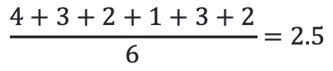
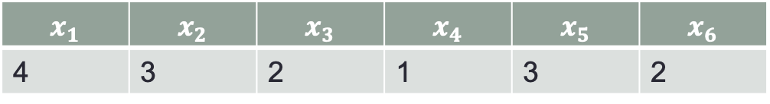
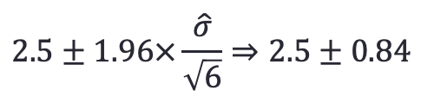
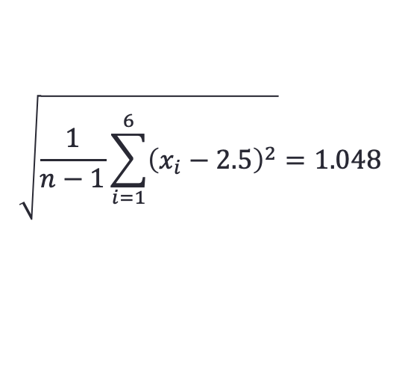
Example 1
What is the 95% confidence interval of the estimate of mean of the following samples.
$$x_{1}$$ | $$x_{2}$$ | $$x_{3}$$ | $$x_{4}$$ | $$x_{5}$$ | $$x_{6}$$
4 | 3 | 2 | 1 | 3 | 2
Step 1. Compute the estimate of mean
$$\frac{4+3+2+1+3+2}{6}=2.5$$
Step 2. Compute the estimate of standard deviation
$$\sqrt{\frac{1}{n−1}\sum_{i=1}^{6}{{\left(x_{i}−2.5\right)}^{2}}}=1.048$$
Step 3. Compute the 95% confidence interval
$$2.5±1.96×\frac{\hat{σ}}{\sqrt{6}}⇒2.5±0.84$$

Slide 9
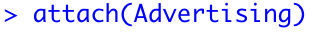
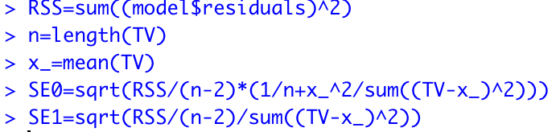
Example 2
Using a linear model to fit the relationship between Sales and TV advertising in Advertising dataset. Compute the 95% confidence interval for intercept and slope.
Step 1. Load the Advertising dataset.
Step 2. Fit a linear model between Sales and TV advertising
R provides a least square fitting function lsfit
Step 3. Compute the 95% confidence interval for $β_{0}$ and $β_{1}$
$$\hat{SE}{\left({\hat{β}}_{0}\right)}^{2}=\frac{RSS}{n−2}\left(\frac{1}{n}+\frac{{\overline{x}}^{2}}{∑{\left(x_{i}−\overline{x}\right)}^{2}}\right)$$
$$\hat{SE}{\left({\hat{β}}_{1} \right)}^{2}=\frac{RSS}{n−2}×\frac{1}{∑{\left(x_{i}−\overline{x}\right)}^{2}}$$

Slide 10

Hypothesis Test
Hypothesis Test includes a null hypothesis and an alternative hypothesis. It tries to test whether the null hypothesis is acceptable based on some experiments.
If a soldier doubt whether the both sides of the coins are the same, what can he do?
The general won’t let him to investigate on each coin. What the soldier know is a single tossing experiment that all 50 coins are head.

Slide 11
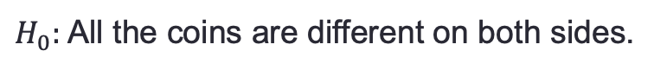
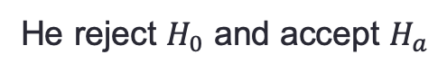
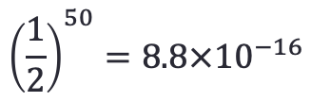
Hypothesis Test
The soldier makes a null hypothesis:
$H_{0}:$ All the coins are different on both sides.
He also makes an alternative hypothesis:
$H_{a}:$ Some of the coins are same on both sides.
He calculates the probability of this experiment:
$${\left(\frac{1}{2}\right)}^{50}=8.8×{10}^{−16}$$
He decides if the probability of the null hypothesis is smaller than a threshold, say 0.05, he will reject the null hypothesis.
He reject $H_{0}$ and accept $H_{a}$

Slide 12
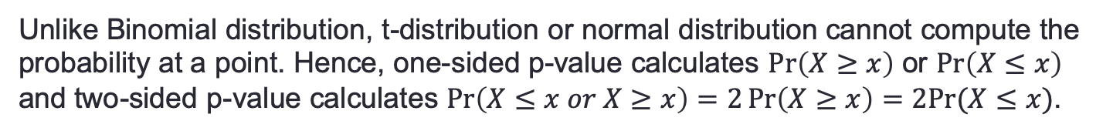
Hypothesis Test – p-value
In practice, the samples follow a t-distribution. This is useful when we don’t know the distribution of the population. t-distribution is very close to normal distribution when the sample size is greater than 30.
Unlike Binomial distribution, t-distribution or normal distribution cannot compute the probability at a point. Hence, one-sided p-value calculates $\operatorname{Pr}\left(X≥x\right)$ or $\operatorname{Pr}\left(X≤x\right)$ and two-sided p-value calculates $\operatorname{Pr}\left(X≤x or X≥x\right)=2\operatorname{Pr}\left(X≥x\right)=2Pr⁡(X≤x)$.

Slide 13
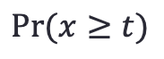
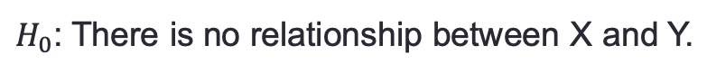
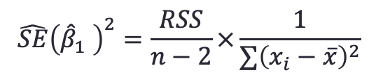
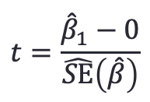
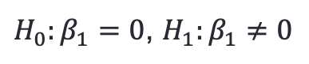
Hypothesis on Linear Model
$H_{0}$: There is no relationship between X and Y.
$H_{a}$: There is some relationship between X and Y.
Mathematically,
$H_{0}:β_{1}=0$, $H_{1}:β_{1}≠0$
We calculate t by
$$t=\frac{{\hat{β}}_{1}−0}{\hat{SE}\left(\hat{β}\right)}$$
$$\hat{SE}{\left({\hat{β}}_{1} \right)}^{2}=\frac{RSS}{n−2}×\frac{1}{∑{\left(x_{i}−\overline{x}\right)}^{2}}$$
We calculate p-value by t-distribution with freedom n-2.
$$Pr⁡(x≥t)$$

Slide 14
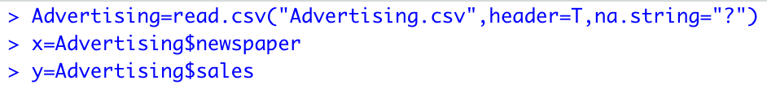
Example 3
Fit newspapers and sales in Advertising dataset using a linear model and test whether they have a relationship or not.
Step 1. Load the dataset.
Step 2. Fit the linear model
Step 3. Make hypothesis.
$H_{0}$: There is no relationship between newspapers and sales, i.e. $β_{1}=0$
$H_{a}$: There is some relationship between newspapers and sales, i.e. $β_{1}≠0$

Slide 15
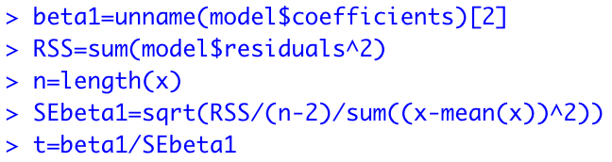
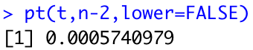
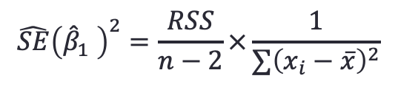
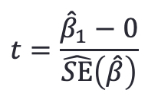
Step 4. Compute the t value
$$t=\frac{{\hat{β}}_{1}−0}{\hat{SE}\left(\hat{β}\right)}$$
$$\hat{SE}{\left({\hat{β}}_{1} \right)}^{2}=\frac{RSS}{n−2}×\frac{1}{∑{\left(x_{i}−\overline{x}\right)}^{2}}$$
Step 5. Compute the p value
Step 6. Decide whether to accept the null hypothesis.
Since the p value is 0.0005 which is significantly smaller than 0.05, the null hypothesis is not acceptable.
**NOTE** 0.05 is an empirical value which is widely used.

Slide 16
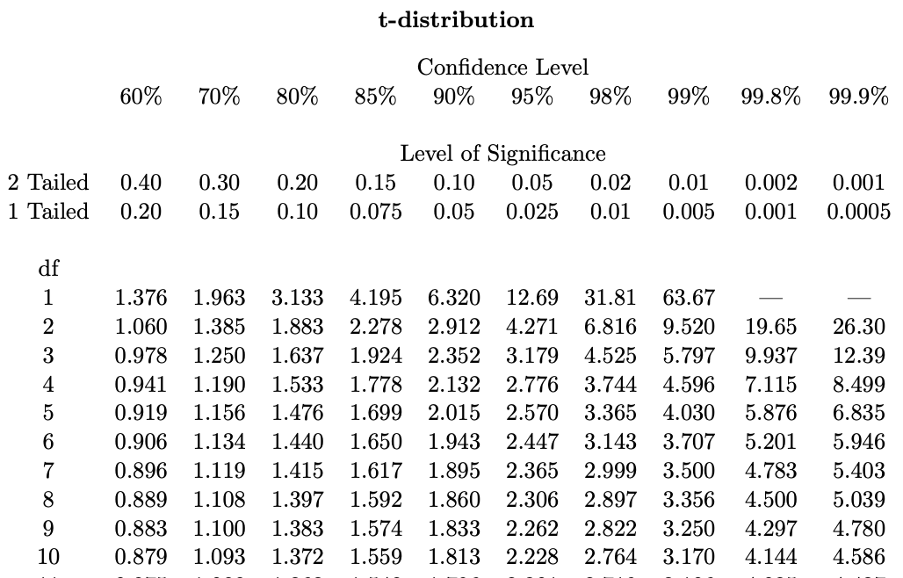
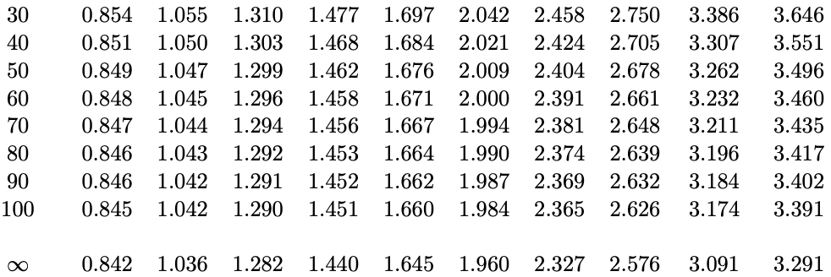
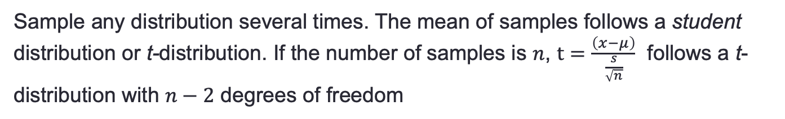
Normal Distribution and Student Distribution
Sample any distribution several times. The mean of samples follows a student distribution or t-distribution. If the number of samples is $n$, $t=\frac{\left(x−μ\right)}{\frac{s}{\sqrt{n}}}$ follows a t-distribution with $n−2$ degrees of freedom
Whenever you calculate confidence interval manually in this course, you can use 1.96 or 2 for the multiplier of standard deviation.

Slide 17
Inference in Regression
Estimated (least squares) line.
14
12
10
The regression line from the sample is not the regression line from the population.
8
6
4
2
0
-10
-5
0
5
10
X
True (population) line. Unobserved

Slide 18
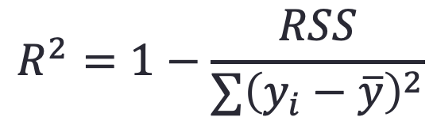
Measures of Fit: R²
Some of the variation in Y can be explained by variation in the X’s and some cannot.
R² tells you the fraction of variance that can be explained by X.
$$R^{2}=1−\frac{RSS}{∑{\left(y_{i}−\overline{y}\right)}^{2}}$$
R² is always between 0 and 1. Zero means no variance has been explained. One means it has all been explained (perfect fit to the data).

Slide 19
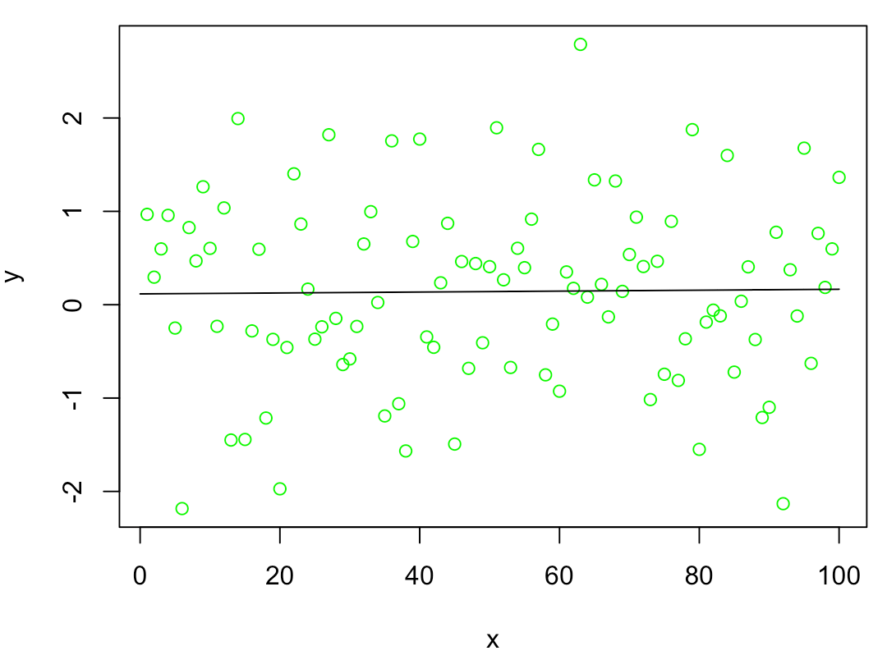
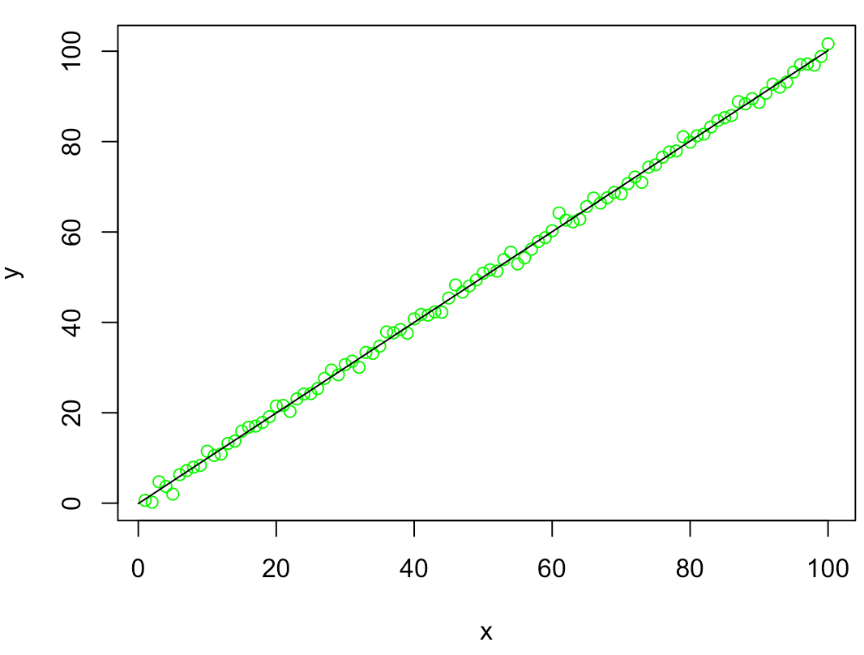

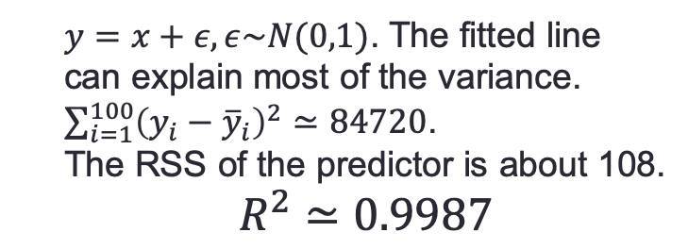
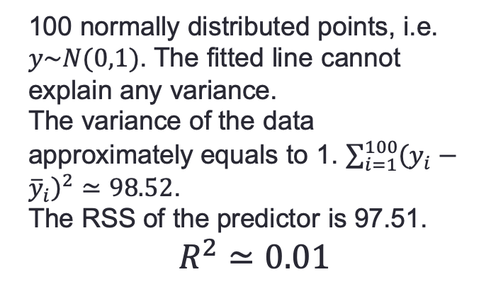
Measures of Fit: $R^{2}$
100 normally distributed points, i.e. $y\sim N(0,1)$. The fitted line cannot explain any variance.
The variance of the data approximately equals to 1. $\sum_{i=1}^{100}{{\left(y_{i}−{\overline{y}}_{i}\right)}^{2}≃98.52}$.
The RSS of the predictor is 97.51.
$$R^{2}≃0.01$$
$y=x+ε, ε\sim N(0,1)$. The fitted line can explain most of the variance.
$\sum_{i=1}^{100}{{\left(y_{i}−{\overline{y}}_{i}\right)}^{2}≃84720}$.
The RSS of the predictor is about 108.
$$R^{2}≃0.9987$$

Slide 20
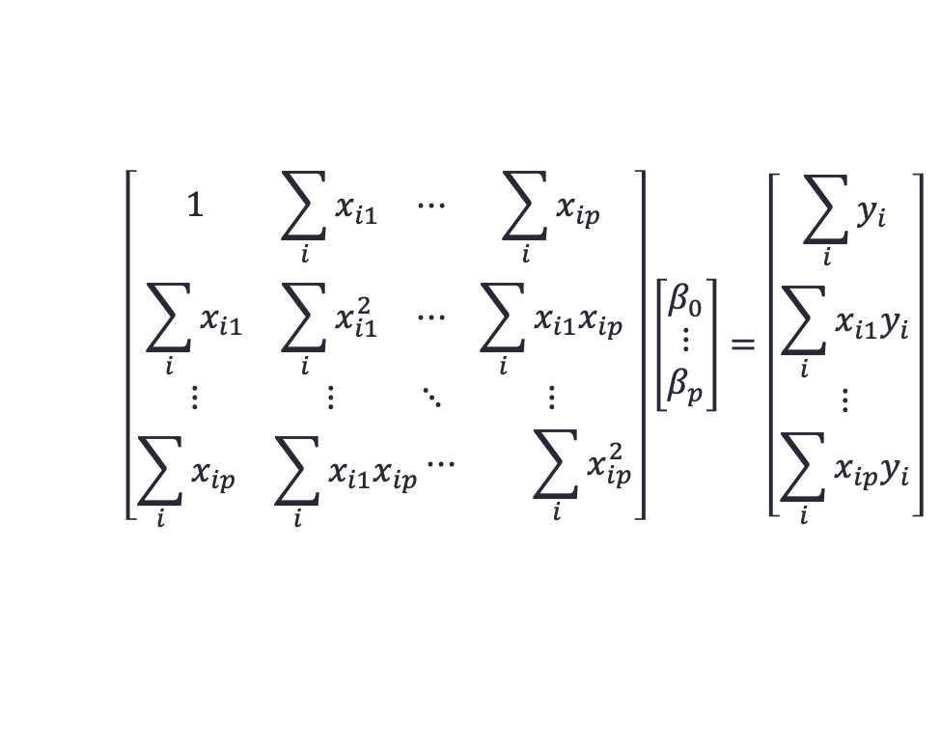

Multiple Linear Regression
$$Y=β_{0}+β_{1}X_{1}+⋯+β_{p}X_{p}+ε$$
$$MSE=\frac{1}{n}\sum_{i=1}^{n}{{\left(y_{i}−{\hat{y}}_{i}\right)}^{2}}$$
$=\frac{1}{n}\sum_{i=1}^{n}{{\left(y_{i}−β_{0}−β_{1}x_{i1}−⋯−β_{p}x_{ip}\right)}^{2}}$
$$\left[\begin{aligned}\begin{matrix}1 & \sum_{i}{x_{i1}} & ⋯ \\ \sum_{i}{x_{i1}} & \sum_{i}{x_{i1}^{2}} & ⋯ \\ ⋮ & ⋮ & ⋱\end{matrix} \begin{matrix}\sum_{i}{x_{ip}} \\ \sum_{i}{x_{i1}x_{ip}} \\ ⋮\end{matrix} \\ \begin{matrix}\sum_{i}{x_{ip}} & \sum_{i}{x_{i1}x_{ip}}\begin{matrix}⋯ & \sum_{i}{x_{ip}^{2}}\end{matrix}\end{matrix}\end{aligned}\right]\left[\begin{matrix}β_{0} \\ ⋮ \\ β_{p}\end{matrix}\right]=\left[\begin{matrix}\sum_{i}{y_{i}} \\ \sum_{i}{x_{i1}y_{i}} \\ \begin{matrix}⋮ \\ \sum_{i}{x_{ip}y_{i}}\end{matrix}\end{matrix}\right]$$

Slide 21
Some Relevant Questions
Is β_{j}=0 or not? We can use a hypothesis test to answer this question. If we can’t be sure that β_{j}≠0 then there is no point in using X_{j} as one of our predictors.
Can we be sure that at least one of our X variables is a useful predictor i.e. is it the case that β₁= β₂=⋅⋅⋅= β _{p}=0?
Which variable is the most important?

Slide 22
1. Testing Individual Variables
Is there a (statistically detectable) linear relationship between Newspapers and Sales after all the other variables have been accounted for?
No: big p-value
Small p-value in simple regression
Almost all the explaining that Newspapers could do in simple regression has already been done by TV and Radio in multiple regression!

Slide 23
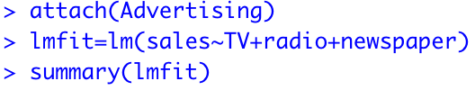
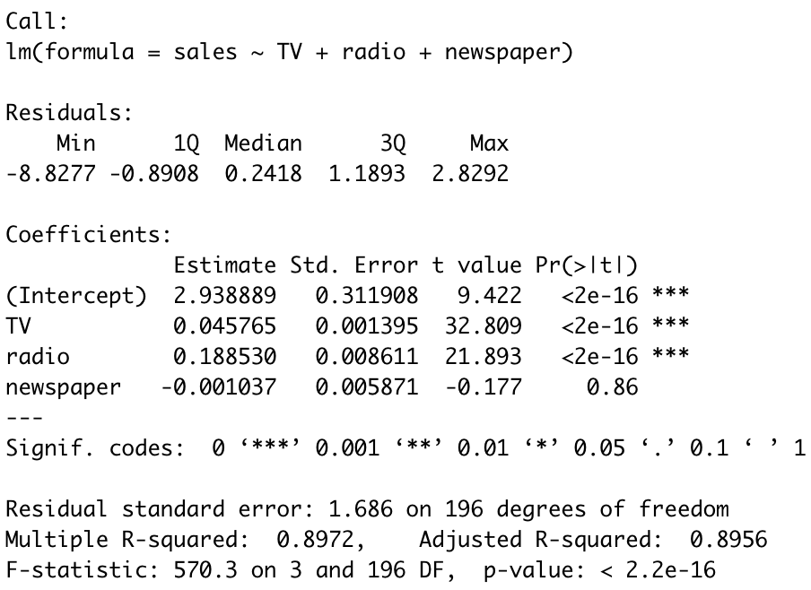
How to make it in R?

Slide 24
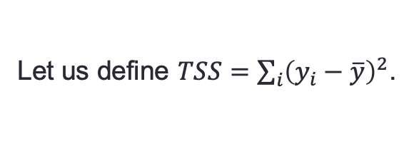
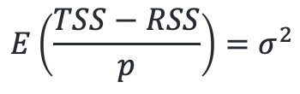

2. Is the whole regression explaining anything at all?
Test for:
H₀: all slopes = 0 (β₁=β₂=⋅⋅⋅=β_{p}=0),
H_{a}: at least one slope ≠ 0
Let us define $TSS=\sum_{i}{{\left(y_{i}−\overline{y}\right)}^{2}}$.
One can prove that
$$E\left(\frac{RSS}{n−p−1}\right)=σ^{2}$$
If the null hypothesis is true, one can prove that
$$E\left(\frac{TSS−RSS}{p}\right)=σ^{2}$$

Slide 25



Let us define
$$F=\frac{(TSS−RSS)/p}{RSS/(n−p−1)}$$
If $F→1$, we could say the null hypothesis is acceptable. If F is much greater than 1, we could say the null hypothesis is unacceptable.
F follows a F distribution. F distribution has two parameters named degree of freedom. In R, we can compute the probability of $F>f$, by

Slide 26







Test whether a subset of coefficients are 0
$$F=\frac{(RSS_{0}−RSS)/q}{RSS/(n−p−1)}$$
$RSS_{0}$ is the residual sum of squares of the new model without the subset being tested. $q$ is number of variables in this subset.
Example 4
Test whether the coefficients of radio and newspaper are 0.
$H_{0}$: $β_{2}=β_{3}=0$
$H_{a}$: at least one of them are not 0.
F:272
We also can use F test for a single coefficient, say newspaper.
$H_{0}$: $β_{3}=0$
$H_{a}$: $β_{3}≠0$.
F: 0.03
F-value: 0.8599

Slide 27
The relationship between t-test and F-test.
Generally, a t-test for a single variable cannot correctly indicates the relationship between the function value and the variable.
No: big p-value
Small p-value in simple regression
Hence, when computing t statistics, the model must be fitted using all variables. F-test can be used to test a single variable, a subset of variables or all variables. **NOTE** When F-test is used for a single variable, the p-value is equal to the p-value of t-test.

Slide 28


3. Which variable is the most important?
For a model of two variables, if we want to decide which is the most important one, we need to test on four models: (1) a model without variables; (2) a model with only variable $X_{1}$; (3) a model with only $X_{2}$; (4) a model with $X_{1}$ and $X_{2}$. For a model of $p$ variables, we need to test on $2^{p}$ models!
Forward Selection. Start from a null model – a model without variables. Separately fit $p$ simple linear regressions for each variable and add to the null model. Keep the variable that results in the lowest RSS. Then, add other variables one-by-one to this new two-variable model. Continue this process until some stopping rule is satisfied.
Backward Selection. Start from a model with all variables. Remove the variable with the largest p value. Fit the new (p-1)-variable model and remove the variable with the largest p value. Continue this process until some stopping rule is satisfied.
Mixed Selection. Start from the null model. As forward selection, add variables one-by-one. When the p value rises above a certain threshold, remove it. Continue this process until all variables have a sufficiently low p-value.

Slide 29
Qualitative Predictors
How do you stick “men” and “women” (category listings) into a regression equation?
Code them as indicator variables (dummy variables)
For example we can “code” Males=0 and Females= 1.

Slide 30
Interpretation
Suppose we want to include income and gender.
Two genders (male and female). Let
then the regression equation is
β₂ is the average extra balance each month that females have for given income level. Males are the “baseline”.

Slide 31
Other Coding Schemes
There are different ways to code categorical variables.
Two genders (male and female). Let
then the regression equation is
β₂ is the average amount that females are above the average, for any given income level. β₂ is also the average amount that males are below the average, for any given income level.

Slide 32

Qualitative Predictors with More than Two Variables

Slide 33

Source: W.-J. Guan et al. clinical characteristics of 2019 novel coronavirus infection in China

Slide 34




Example 5. Simple Linear Model in R

Slide 35

Example 6. Multiple Linear Regression

Slide 36

Summary
Simple linear model. A linear model only has one variable.
Compute the confidence interval for coefficients of simple linear model. The equations of $\hat{SE}(β_{0})$ and $\hat{SE}(β_{1})$ will be given if it is used in the examination.
How to compute p-value for $β_{1}$ of a simple linear model in R. (optional)
How to test the null hypothesis that $β_{1}=0$. (optional)
How to use lm function in R to make t-test and F-test on a single variable or multiple variables.
How to use R to fit a linear model and make some predictions.

